Slide 1
Easy Home Automation

Slide 2
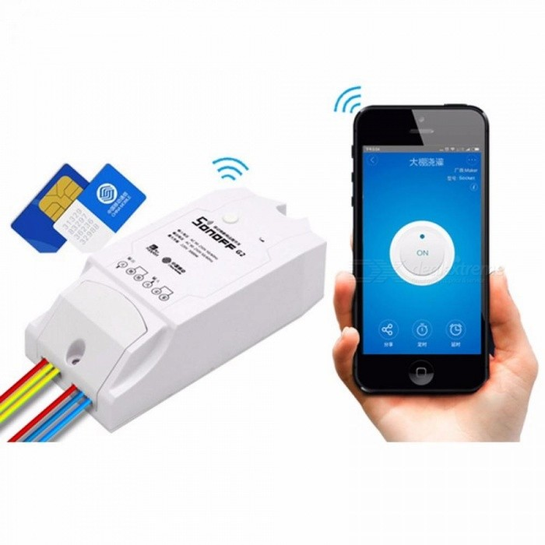
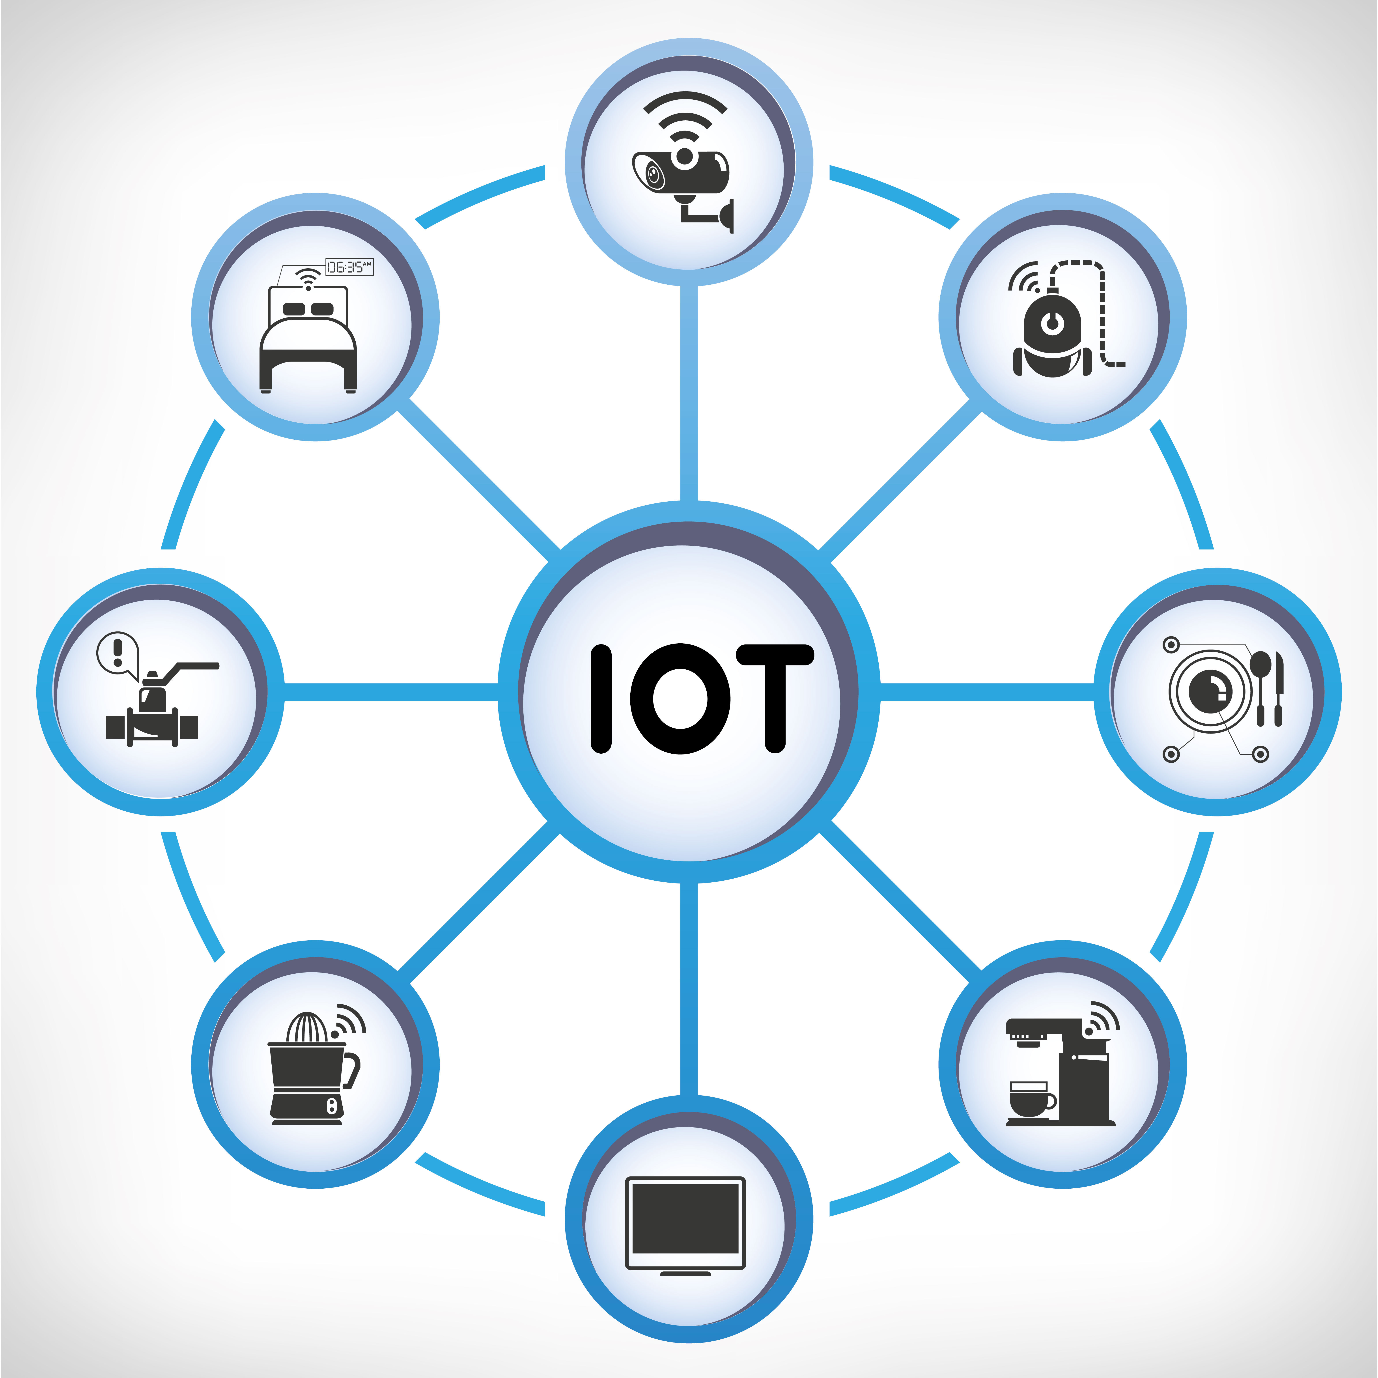
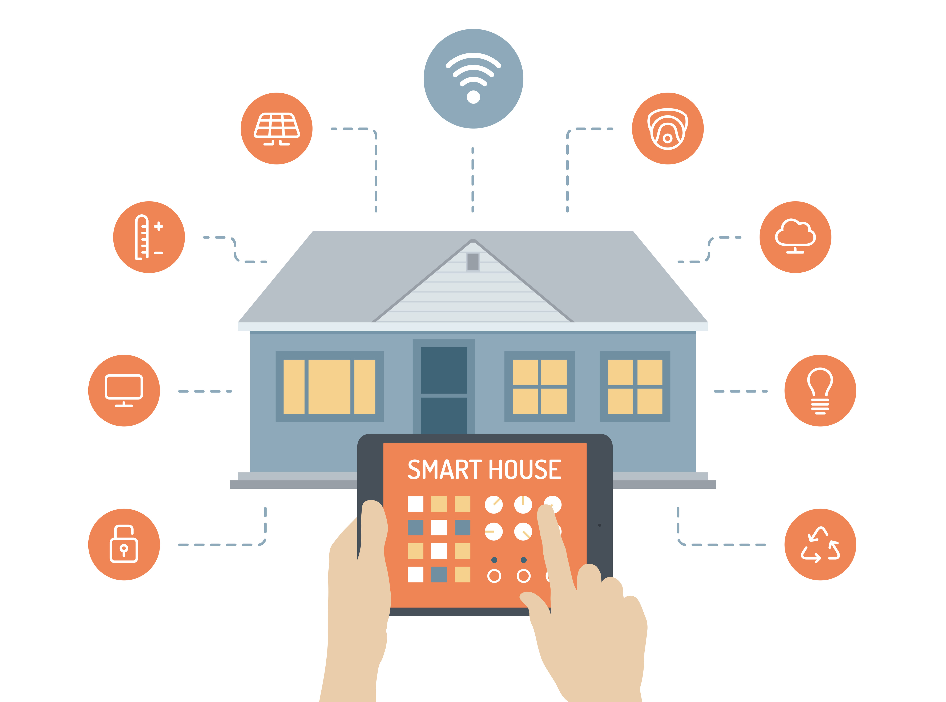
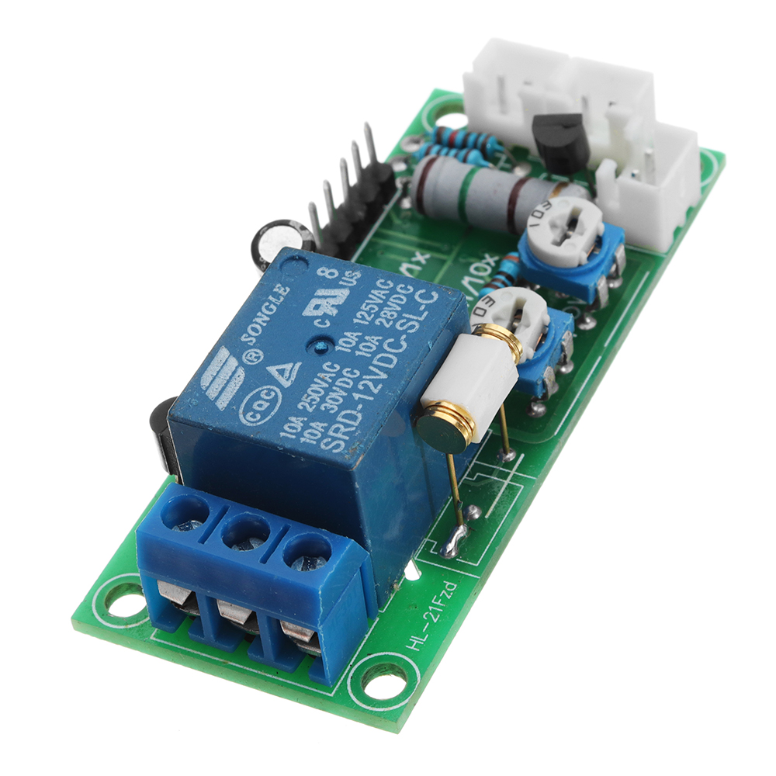
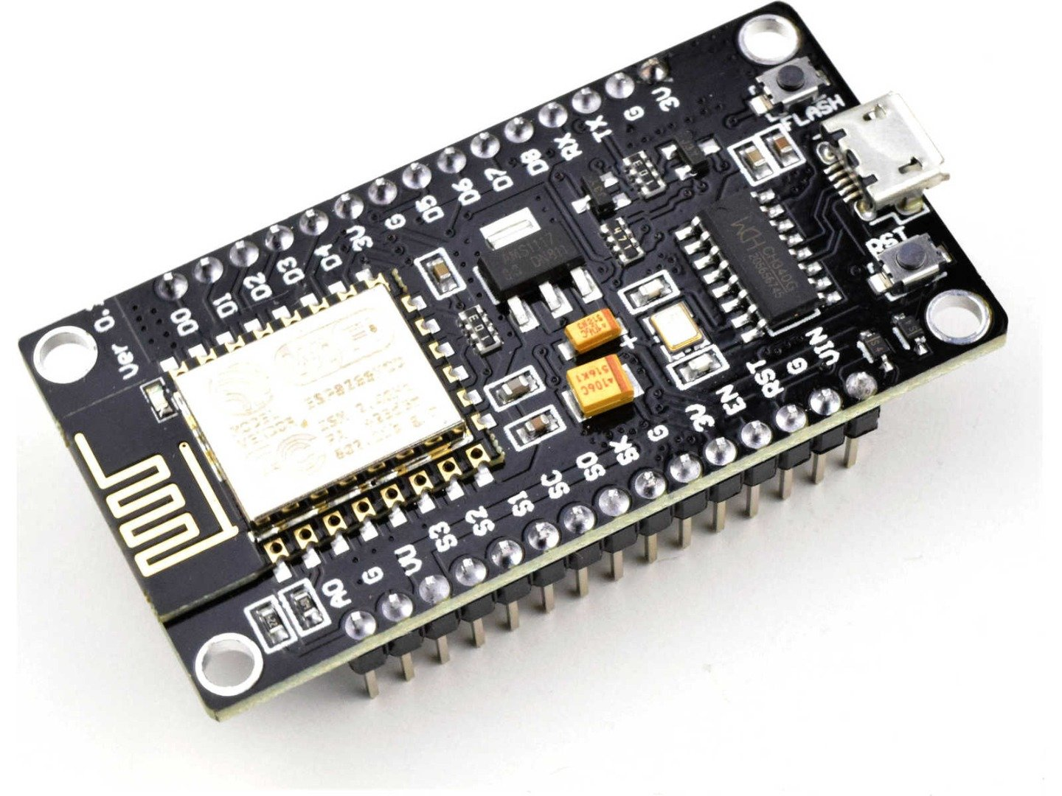
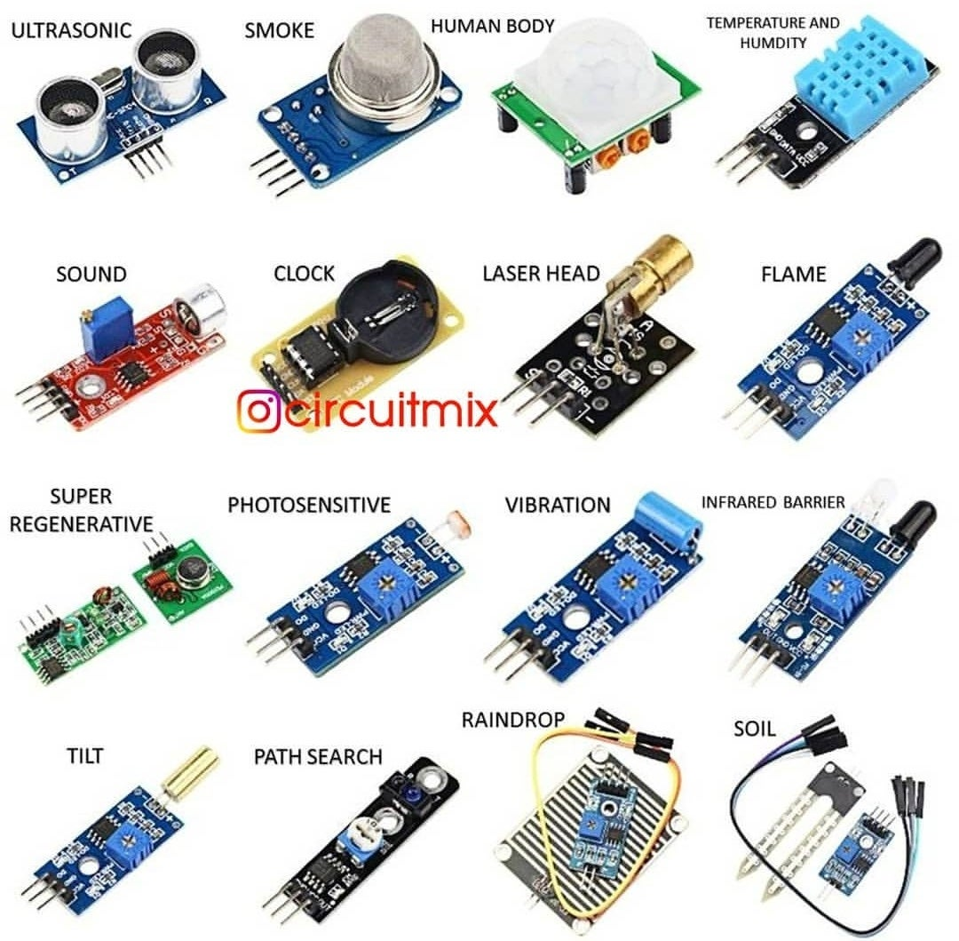
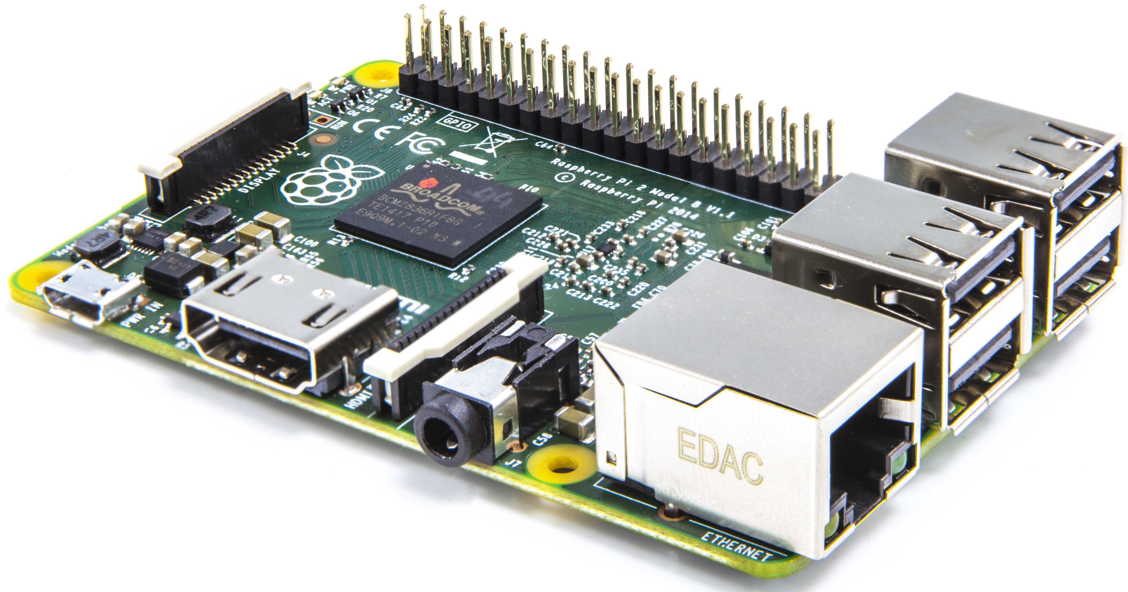
How to make your home smarter?

Slide 3

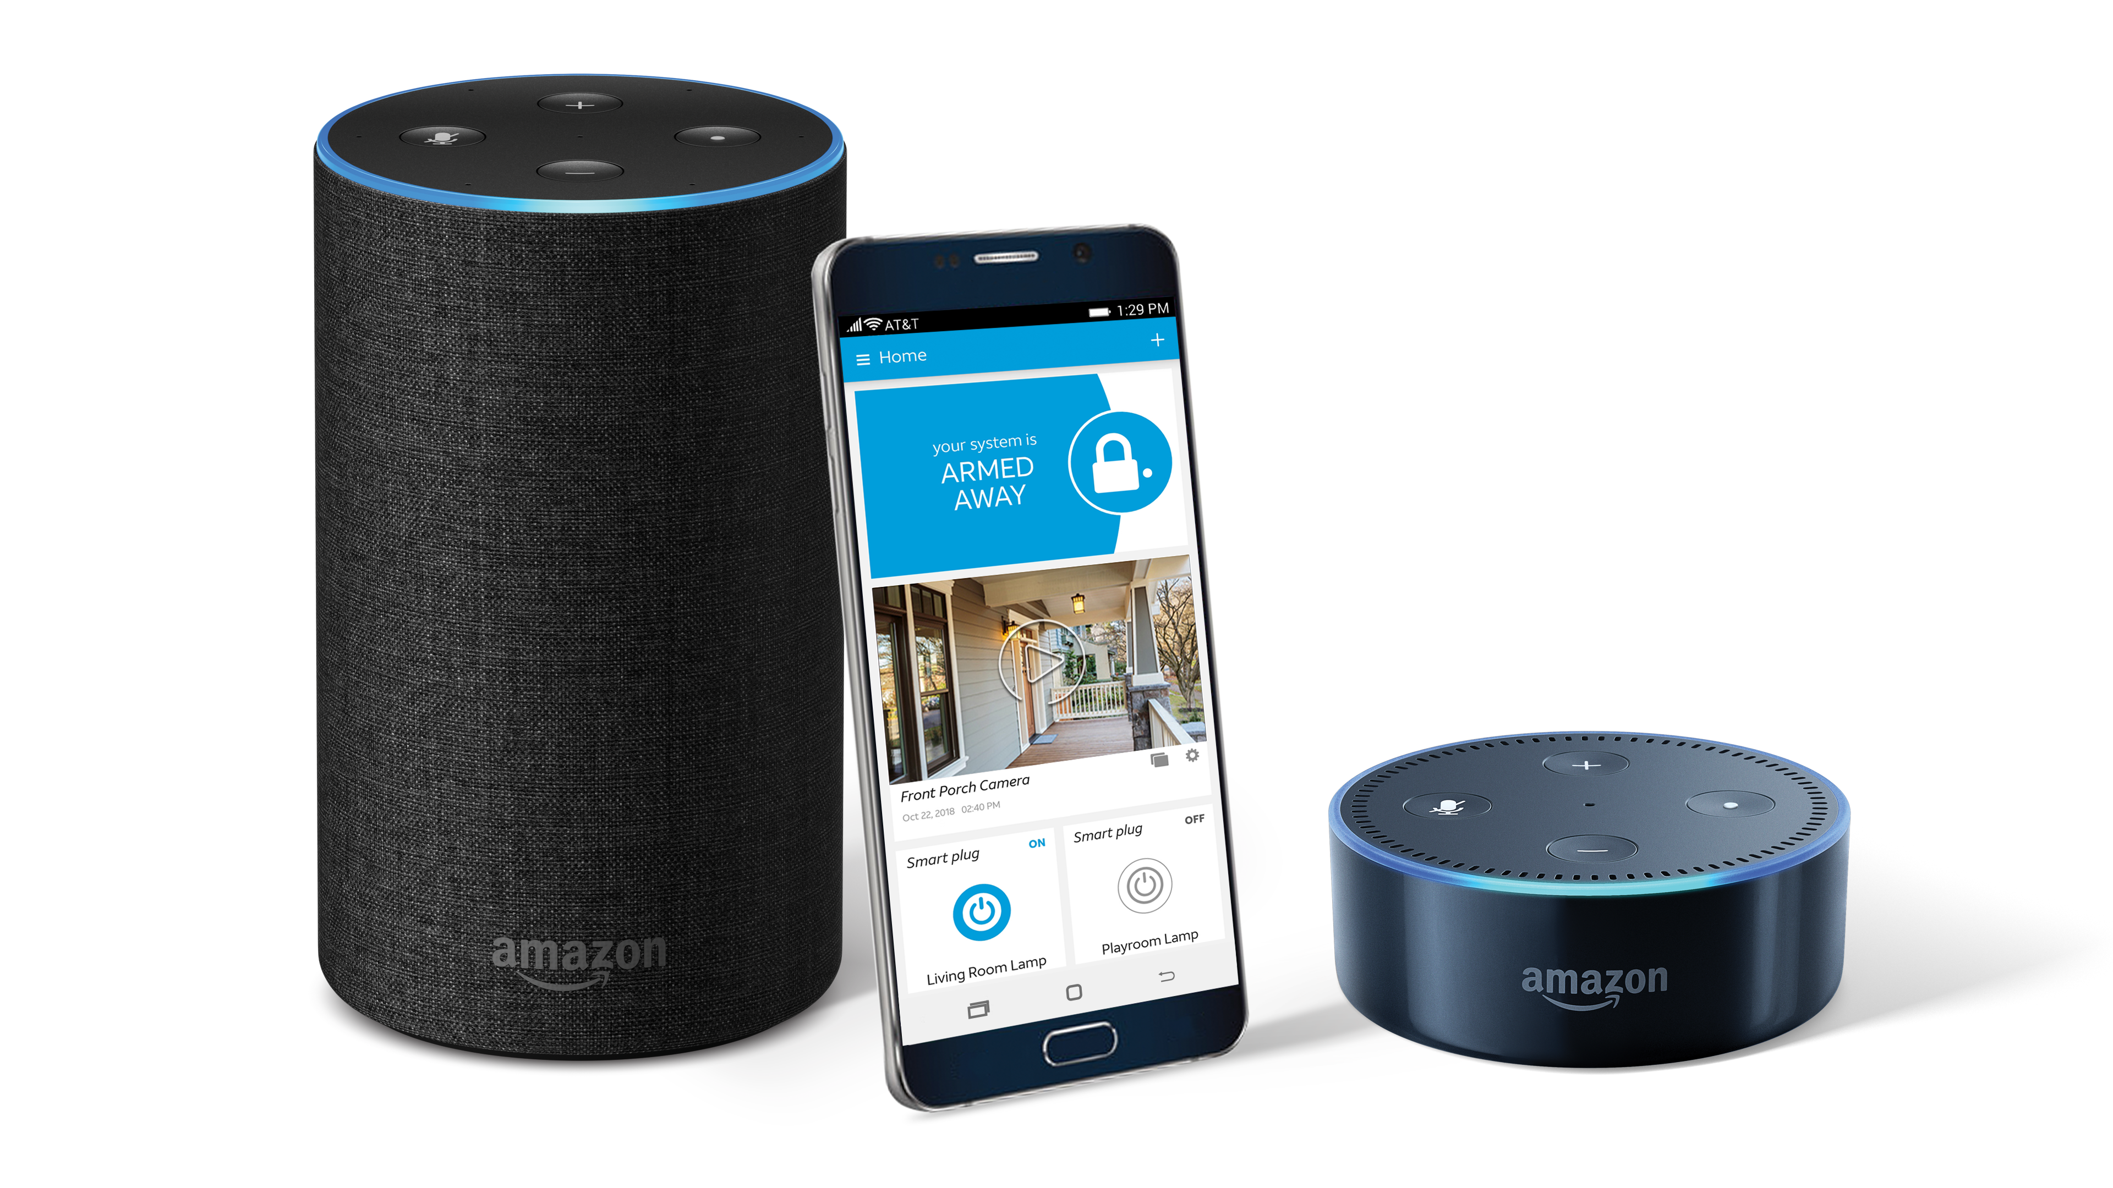
Home Automation Architecture
Manual Switch
Electric Appliance
Home Automation Server (Raspberry Pi)
AutomationSwitch 1 (Relay+NodeMCU)
myOpenHAB.org
Mosquitto (MQTT Broker)
Internet
AutomationSwitch 2 (Relay+NodeMCU)
OpenHAB (IoT Platform)
MQTT Message
MQTT Message
AutomationSwitch 3 (Relay+NodeMCU)
AutomationSwitch n (Relay+NodeMCU)
Grafana (Dashboards)
InfluxDB
(Time-Series DataStore)

Slide 4

Extending with Intelligence
MQTT
MQTT Broker (Mosquitto)
PowerControl Microservice
Ambience Microservice
Switch
Control
Switch
Trigger
ControlJSON
{“Switch1”:1, “Switch2”:0, “Switch3”:1, “Switch4”:1,
“Switch5”:0, “Switch6”:0,
“Switch7”:1}
OpenHAB
Edge NodeMCU (PowerControl)
Power Report
Ambience Report
SwitchControlServer
Publish/Subscribe MQTT
REACT.JS
REACT.JS
Python (ML)
Python (ML)
PostGreSQL
PostGreSQL
InfluxDB
Edge NodeMCU (Ambience)
AmbienceReportingServer
Home Automation Server (Raspberry Pi)
{Topic: Ambience, AmbienceData:
{“Temp”:23, “Humidity”:76, “Sound”:78}
{“Motion”:true, “Smoke”:76, “CO2”:78}}
IoT Platform (myOpenHAB.org)

Slide 5
Electrical Design
Edge Gateway (NodeMCU)
NodeMCU1 (Sensor)
3.3V
DTH
Motion
Sound
Power Supply
NodeMCU1 (PowerControl)
VCC GND
5 4 14 12
5V
4 Ch Relay 1
240V
S1
LED1
LED2
LED1
LED2
LED5
LED6
S2
S3
S4

Slide 6
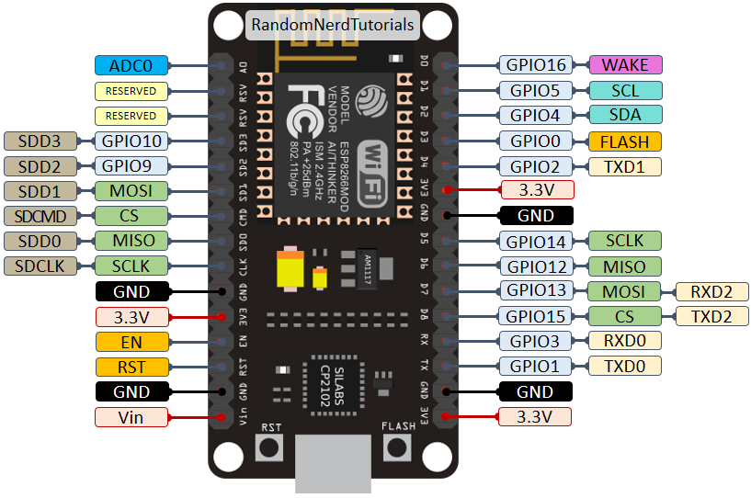
S1
10/SD3
5/D1
R1
4/D2
R2
14/D5
R3
S2
0/D3
12/D6
R4
S2
13/D7
S2
3/Rx

Slide 7
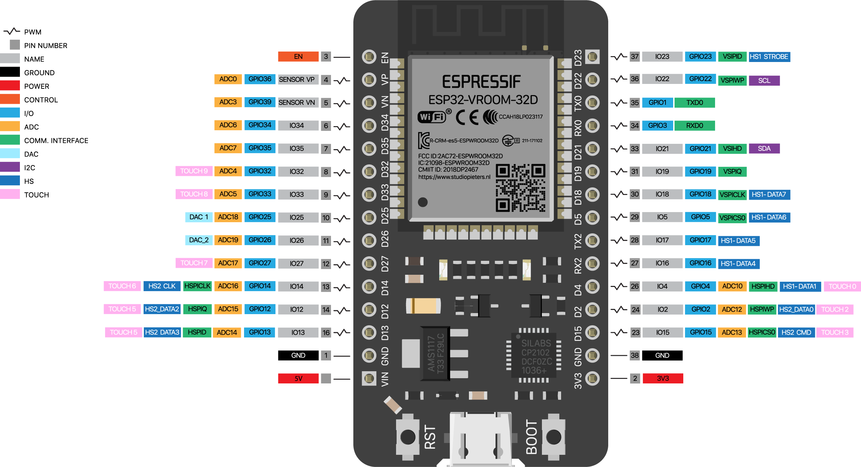
23/D23
R1

Slide 8
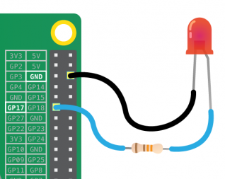
Using Raspberry Pi as IoT Gateway
Raspberry Pi is a low cost, credit-card sized computer that plugs into a computer monitor or TV, and uses a standard keyboard and mouse.
It has a set of general purpose digital I/O pins (GPIO) which can be used to interface with any digital sensor or control (e.g. blinking LED)
It can also interface with serial device such as Arduino to exchange data
It can run any program coded in any programming language such as Java/Python/Node.js and integrate with Cloud of or other external applications like any computer
Node.js/Python
Call from anywhere
REST Service
Raspberry PI

Slide 9
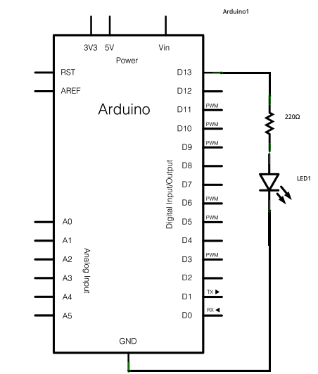
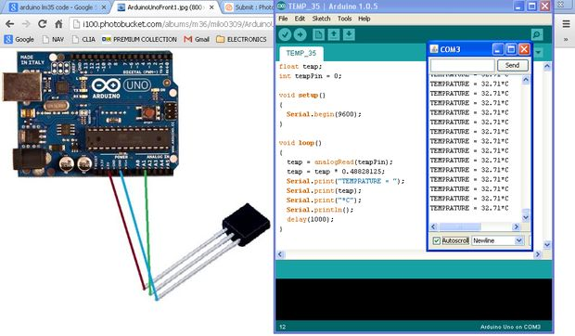
Connecting with The Sensor and Getting the Data
Arduino is a cheap micro-controller board which can be used to easily interface with any sensor. It can read and write both analog and digital data from and to its I/O pins and can be programmed in C++ (using Arduino IDE)
Arduino can exchange data with other computers or devices through the serial port

Slide 10
Data Model for home Automation – Switch Control
Table Name: SwitchControl (PGSQL)
Column Name | Description | Data Type
NodeID | ID of Control Board | String
SwitchID | ID of Switch | String
DeviceID | ID of Connected Device | String
Description | Description of Device/Sensor | String
Power | Power Consumption by Device in Wattage | Decimal
Table Name: SwitchState (InfluxDB)
Column Name | Description | Data Type
Measure | ID of Switch | String
State | On or Off | Boolean
DateTime | Timestamp of the state change | Timestamp

Slide 11
Data Model for home Automation – Ambience control
Table Name: AmbienceControl (PGSQL)
Table Name: AmbienceMeasureSchedule (PGSQL)
Column Name | Description | Data Type
NodeID | ID of Control Board | String
SensorID | ID of Sensor | String
Description | Description of Device/Sensor | String
LowerLimit | Lower Threshold Limit of the Sensor value | Decimal
UpperLimit | Lower Threshold Limit of the Sensor value | Decimal
UOM | Unit of measure of sensor value | String
Column Name | Description | Data Type
NodeID | ID of Control Board | String
SensorID | ID of Sensor | String
MeasureInterval | Time interval of measure in seconds | Decimal
MeasurePauseStartTime | Time of start of pause measure daily | Time
MeasurePauseEndTime | Time of end of pause measure daily | Time
Table Name: AmbienceMeasure (InfluxDB)
Table Name: AmbienceEvent (PGSQL)
Column Name | Description | Data Type
Measure | ID of Sensor | String
SensorValue | Measured value by sensor | Decimal
DateTime | Timestamp of the measure | Timestamp
Column Name | Description | Data Type
NodeID | ID of Control Board | String
SensorID | ID of Sensor | String
SensorValue | Threshold value by sensor | Decimal
Operator | Operator sign of the threshold value comparison | String
DelayTime | Time to measure and condition fulfilment in seconds | Decimal
ServiceToCall | Service to call on condition fulfilment | String

